Slide 1
AACS Conference at Pepperdine University, Malibu, CA (10/9/2016) “Between a Rock and a Hard Place: Border Minorities in China’s Foreign Relations with South Asia”
By Bibek Chand & Lukas K. Danner
Department of Politics & International Relations
Green School of International & Public Affairs
Florida International University, Miami, FL

Slide 2
Overview
General Introduction
China’s Border Policy
Uyghurs & Sino-Pakistani Relations
Tibetans & Sino-Indian Relations
Tibetans & Sino-Nepali Relations
Conclusion

Slide 3
General Introduction
Much recent attention on conflicted maritime borders
S China Sea
E China Sea
Other border regions relatively neglected
S Asian neighboring states
Border minorities’ role in relations with Pak, Ind, Nep
w/ Pak: Uighur minority
w/ Ind & Nep: Tibetan minority
RQ: What role do minorities play in China’s rel. w/ S Asia?

Slide 4
China’s General Border Policy
China’s own experience w/ semi-colonization
➔ developed over-emphasis on sovereignty & non-interference in internal affairs
WW II made the ‘golden rule’ of sovereignty less important (R2P)
China not a subscriber to most Western individual HR
➔ PRC as the legal successor to a pan-ethnic empire
➔ Keeping Xinjiang (Uighurs) and Tibet from creating own nation-states intricately important to existence of PRC

Slide 5
China’s General Border Policy (cont.)
Enforcing non-support for Uighur or Tibetan nation-state by accepting that they are integral parts of China, if official relations
1.3 billion economic market
Case for self-determination of Uighurs and Tibetans is strong based on common history, culture, language, and religion concentrated on territory
➔ fear of domino effect for other regions
‘Empty Fortress’ strategy in China’s West
Establishment of SCO
Higher goal = stability at borders, avoid ‘spillover effects’

Slide 6
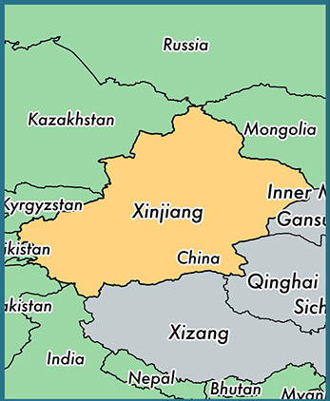
Uyghurs & Sino-Pakistani Relations
Pak often portrayed as important PRC ally
Uighur minority actually cause of friction
“In the late 1940s, thousands of Uighurs emigrated to Pakistan, fearing Chinese repression” (Rahman 2005)
Small minority in Pakistan—only about 3,000 people strong
Terrorist training camps for Uighurs in Pak
Postulated repatriations from Chinese side
“Uighur separatism is just as likely to drive China and Pakistan apart as to push them together” (Scobell et al. 2015, 64f.)
However, “Chinese officials are increasingly connecting the level of terrorist activity in Pakistan to instability in western China” (Pamidi 2012, 84)
Source: http://www.worldatlas.com/
img/world-state/xinjiang-autonomous
-region-china.jpg

Slide 7
Tibetans & Sino-Indian Relations
India as counterweight to China and archenemy of Pak a natural enemy of China’s
India houses the largest Tibetan refugee population (35 settlements; 100,000+) and its exiled government/the Dalai Lama—another contentious issue
Though cordial relations at outset of CW, hot war in the 1960s over border disputes that continue to this day (Arunachal Pradesh, Aksai Chin)
India continued policy of welcoming Tibetan refugee
Historically, (British) India wanted Tibet to be a buffer as second line of defense
China uses India’s acquiescence to the Tibetans as reason to fortify its TAR & denies visa applications from Indian citizens living in AP
➔ Tibetans are an important factor in the Sino-Indian relationship

Slide 8
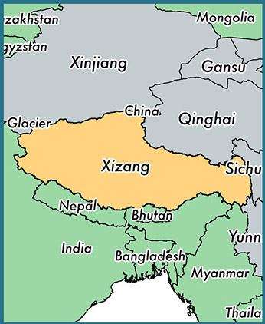
Tibetans & Sino-Nepali Relations
Second largest Tibetan refugee population (20,000)
As China rose in the past decades, its influence in Nepal also increased w/ Nepalese change in government structure/state form facilitating that trend:
More and more Chinese foreign aid & infrastructure projects to/in Nepal tied to putting pressure on Tibetans in Nepal
Among other aid, Nepalese police received proper gear to carry out repressions
➔ Overall growing influence of China in Nepal that affects Tibetans there and serves a dual balance to counter Ind’s influence in Nepal
Source: http://www.worldatlas.com/
img/world-state/xizang-tibet-autonomous-
region-autonomous-region-china.jpg

Slide 9
Conclusion
Border minorities in China’s West form an important factor in its relations with South Asia
➔ Domestic dimension factoring into the international level
➔ Set to be a continuing problem for the PRC as its bare existence is connected to keeping its western minority-dominated territories, Xinjiang and Tibet
➔ China also affected by the wave of Islamic terrorism of the recent past
Differences in how the border minority factor influenced the relations in South Asia based on the nature
Pak: Mixed—cooperation and contention (terrorist camps)
Ind: Mostly contentious; disputed territory belonging to Tibet
Nep: Cordial relations; pressure on Tibetans intensifies

Slide 10
Thanks for support from
American Association for Chinese
Studies (AACS) Junior Travel
Grant, 2016

Slide 11
Thank you.

